Slide 1
INTELLIGENT TELE-COMMUNICATION SYSTEM USING SEMANTIC BASED INFORMATION RETRIEVAL
PRESENTED BY: P. Jothy
P. Nishanthiny

Slide 2

INTELL.COMM

Slide 3
ABSTRACT
Present telecommunication call recording systems has the ability to accept and record the voice calls, in absence of the user. But the user or the system cannot predict the importance of message of the caller
To make the telecommunication more effective and intelligent. An Intelligent agent which has a semantic Analyzer, processes natural human language to infer a content through ontology, which correlates with linguistical characteristics of the speaker
An epistle is sent to the user in case of exigency or the voice message is stored by default method

Slide 4
PROBLEM DEFINITION:
Ontology based information retrieval system are used in web search, data mining, etc.,
In the field of telecommunication, it is not been so far implemented
Present telephony system only records the voice call but will not analyze the content of the voice call
User may not know the emergency of the message until the user hears the message

Slide 5







Slide 6
PROPOSED WORK
Recording the call as per the existing telephony system
Activating an Artificial Agent to act on the recorded message
Natural Language processing and semantic analyzer is used by the agent to process the voice clip
Using an Ontology based information retrieval to predict the meaning of the voice call
By matching the pre-defined keywords and criteria from the database, the agent concludes the rate of emergency of the message

Slide 7


Slide 8




Slide 9
TECHNIQUES IMPLIED:
Semantic Data[3] retrieval - can be done by Semantic Indexing
Gather knowledge from the web and store it as meta-data for easy data retrieval[4]
Natural language processing using Parts of speech tagging, lemmatization and word sense disambiguation
- None of these search technique and language processing is so far implemented in Telephony system

Slide 10
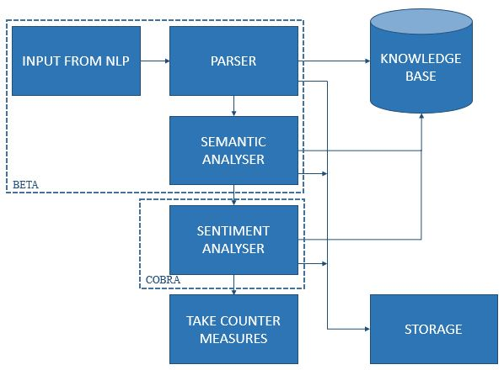
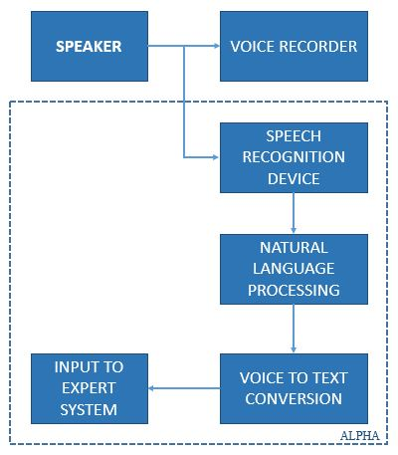
ARCHITECTURE DIAGRAM:

Slide 11
PROCESS FLOW DIAGRAM:
Agent ALPHA
Activated
Agent BETA
Activated
Agent COBRA
Activated
NOT EMERGENCY
Store to Memory
15 SECOND TIMER
Attend the
Phone call
Natural Language processing
Voice to text
Semantic Analyzer & Ontology retrieval
Agent GAMMA
Activated
CALL
Record voice message
Send Result to GAMMA
Send to COBRA
Send to BETA
SEND TO BACKUP CONTACT

Slide 12
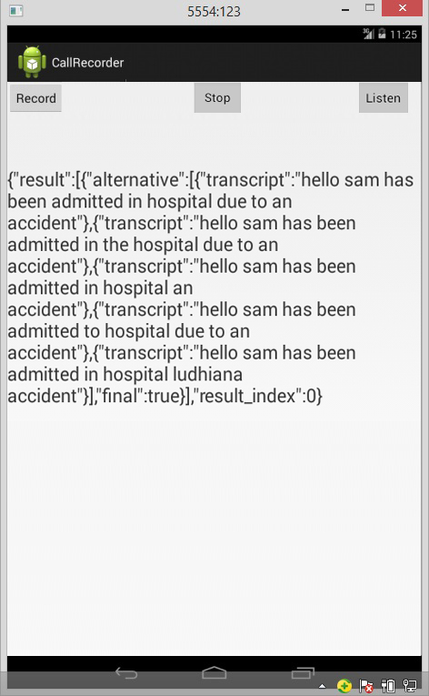
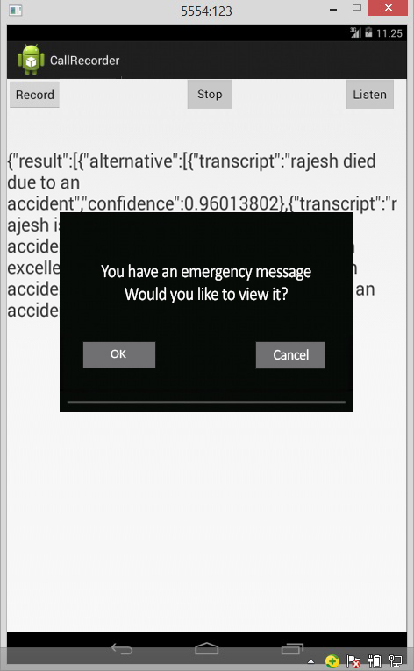

Slide 13
COMPARISON WITH EXISTING SYSTEM
FEATURES | EXISTING SYSTEM | PROPOSED SYSTEM
Automated voice recording | Yes | Yes
Analyzing a voice call | No | Yes
Convert to text | No | Yes
See if emergency message | No | Yes
Over-ride silent to deliver message | No | Yes
Self-Learning keywords and synonyms | No | Yes

Slide 14
CONCLUSION
The state of emergency is prevailing all the time, but noticing it at the right time becomes a problem
So we can use an external agent who can keep a responsibility of delivering the right messages at right time

Slide 15
FUTURE ENHANCEMENT:
Modern tools and approaches can be implemented
Can be made as an app and can be used in mobile phones
To avoid wrong alert through prank calls parser, sentiment analyzer acoustic analyzer can be additionally implemented
An Intelligent agent can be implemented at the service provider server, such that network coverage problems can be overpassed.

Slide 16
REFERENCE
[1] Using semantic techniques to access web data, Raquel Trilloa, Laura Pob, Sergio Ilarria, Sonia Bergamaschib, Eduardo Mena – IIS Department, University of Zaragoza Maria de Luna 1,50018 Zaragoza, Spain II Department, University of Modena and Reggio Emilia, Via Vignolese 905,41125 Modena, Italy. www.elsevier.com/locate/infosys
[2] An antology - based retrieval system using semantic indexing, Soner Kara, Ozgur Alan, Orkunt Sabuncu, Samet Akpinar, Nihan K. Cicekli, Ferda N. Alpaslan Department of Computer Engineering, METU, Ankara,Turkey Article (22 September 2011) www.elsevier.com/locate/infosys
[3] Properties and Models of Software Agents and Agent System, Prof. Dr. Erika Horn, Mario Kupries, Drik, Department of Computer Science Am Neuen Palais 10 14469 Potsdam Europe, Germany
[4] Test Coverage Criteria for Agent Interaction Testing, Tim Miller, Lin Padgham and John Thangarajah, Department of Computer Science and Software Engineering, University of Melbourne, Department of Computer Science, RMIT University, Melbourne, Australia
[5] A Metrics Suite for the Communication of Multi-agent Systems, C. Gutie`rrez and I.Garcia-Magarino.
[6] Expert System with Applications, SWSNL : Semantic Web Search Using Natural Language, Ivan Habernala, Miloslav Konopikb Department of Computer Science and Engineering, Faculty of Applied Sciences, University of West Bohemia, Univerzitni`
[7] Expert Systems with Applications, Semantic Web service discovery using natural language processing techniques, Jordy Sangersa, Flavius Frasincara, Frederik Hogenbooma, Vadim Chepegin Erasmus University Rotterdam, Netherlands.

Slide 17
[6] Expert System with Applications, SWSNL : Semantic Web Search Using Natural Language, Ivan Habernala, Miloslav Konopikb Department of Computer Science and Engineering, Faculty of Applied Sciences, University of West Bohemia, Univerzitni
[7] Expert Systems with Applications, Semantic Web service discovery using natural language processing techniques, Jordy Sangersa, Flavius Frasincara, Frederik Hogenbooma, Vadim Chepegin Erasmus University Rotterdam, Netherlands.
[8] J. Cardoso, The Semantic Web vision : where are we? IEEE Intelligent Systems 22(5) (2007)
[9] The Semantic Web, T. Berners-Lee, J.A. Hendler, O. Lassila,Scientific American 284(May 5 2011)
[10] E.Miller, Reuse, repurpose, remix, in: Proceedings of the Semantic Technologies Conference 2008,San Jose, CA
[11] Software Agent Technology: An overview Application to Virtual Enterprises, Chrysanthi E. Georgakarakou & Anastasios A. Economides Information Systems Department University of Macedonia.
[12] Software Agents: A Literature Survey(10.6.2005) Helsinki University of Technology Systems Analysis Laboratory.
[13] Investigation into Self-Adaptive Software Agents Development, E. Grishikashvili, http://www.cms.livjm.ac.uk/cmsegris/Deliverables/Reports/

Slide 18
Queries..

